Slide 1

Current topics in bioinformatics
ChIP-seq and ATAC-seq workshop 2019
Jonas Ungerbäck
Ph.D – Sigvardsson lab

Slide 2
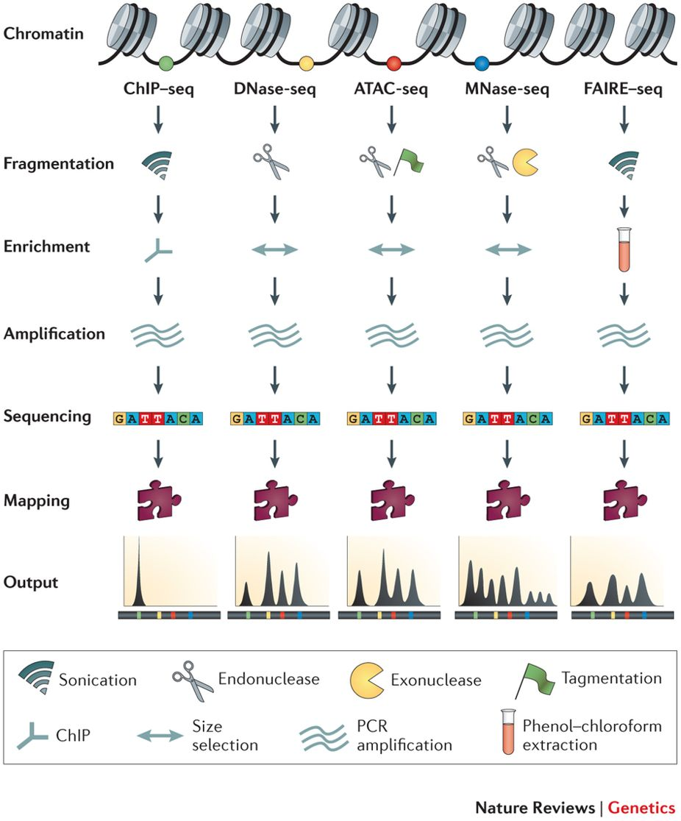
Common methods for chromatin/DNA-binding profiling on masse
Meyer and Liu, Nat Rev Gen (2014)

Slide 3
What is ChIP-sequencing?
Chromatin immunoprecipitation (ChIP) coupled to high-throughput sequencing.
Allows for mapping of protein-DNA interactions.
Important pointers for good experimental design.
Biological replicates.
-Reproducible ChIP-seq peak discovery is a science on its own and we will only cover the basics here.
ChIP-seq controls.
Knock-out phenotype if possible.
Input controls
Avoid IgG in modern ChIP protocols.

Slide 4
What is ChIP-sequencing?
Cross-link chromatin.
Fragment chromatin.
Immunoprecipittíon.
Wash, reverse X-linking and DNA-elution.
(Another fragmentation)
End-repair and A-tailing.
Adapter ligation and indexation.
Final clean up.
Measure library size and concentration.
Sequence.
Illumina
Illumina sequencing by far the most
common but beware when analyzing
old data in color space or newer
techniques like Pac-Bio.
https://homolog.us/blogs/tech/2010/02/15/the-mathematics-behind-color-space-sequencing/
https://www.pacb.com/
Notes:
Talk about ways to crosslink and fragment chromatin.

Slide 5
What is ATAC-sequencing?
Enables measurement of “chromatin accessibility”.
Does not require the use of an antibody.
Hyperactive Tn5 transposase is used to fragment DNA and integrate into open chromatin.
Usually 500-50k cells is needed but scATAC-seq exists.
Can be used to detect nucleosome position and TF footprints.
Important pointers for good experimental design.
Replicates, same as for ChIP-sequencing.
Beware, there is a Tn5 sequence bias.
No good negative control can make signal-to-noise separation tricky. More bioinformatical “massaging” often necessary.
Know you cell type. Mitochondrial reads can be a huge problem but newer protocols have been developed to partly deal with that problem (Omni-ATAC).

Slide 6
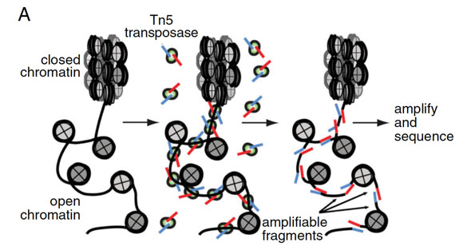
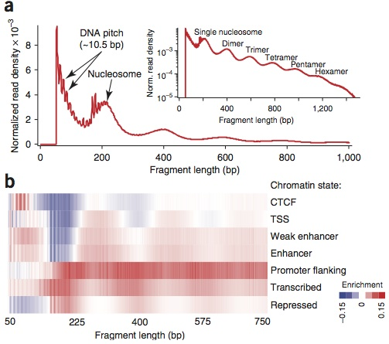
What is ATAC-sequencing?
Buenrostro et al 2013.

Slide 7
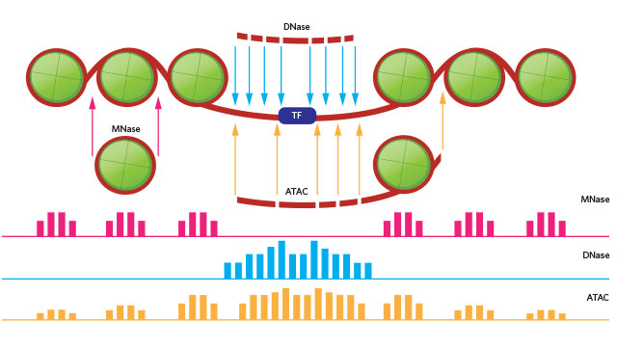
What is ATAC-sequencing?
Footprint
Thomas Carrol: https://rockefelleruniversity.github.io/RU_ATAC_Workshop.html

Slide 8
A generalized ChIP-seq workflow
Peak
calling
Peak overlap
Trim reads
Format specific.
Homer needs a
Tag Directory.
Homer.
Bedtools
(IDR, advanced)
Alignment
Duplication
removal
Motif
finding
Annotation
Differential
peaks
If applicable (PE)
Blacklist
removal
Plotting, histogram
etc.
Why do we use this? They are very common tools and the ones I am familiar with. That being said there are many many options for peak finding and annotation. Find what works for you.

Slide 9
A generalized ATAC-seq workflow
Trim reads
Peak
calling
Peak overlap
Different parameters compared to ChIP
Homer.
Bedtools
(IDR, advanced)
Alignment
Remove
chrM
Motif
finding
Annotation
Differential
peaks
Duplication
removal
Overlapping
ChIP-seq
Plotting, histogram
etc.
Blacklist
removal

Slide 10
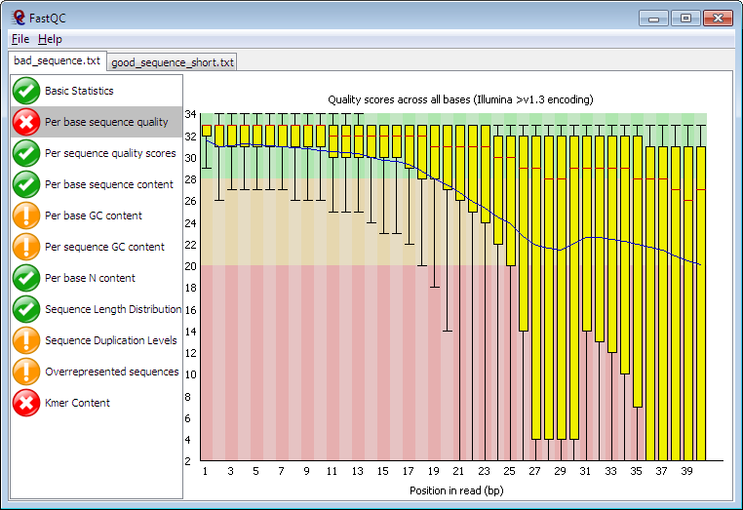
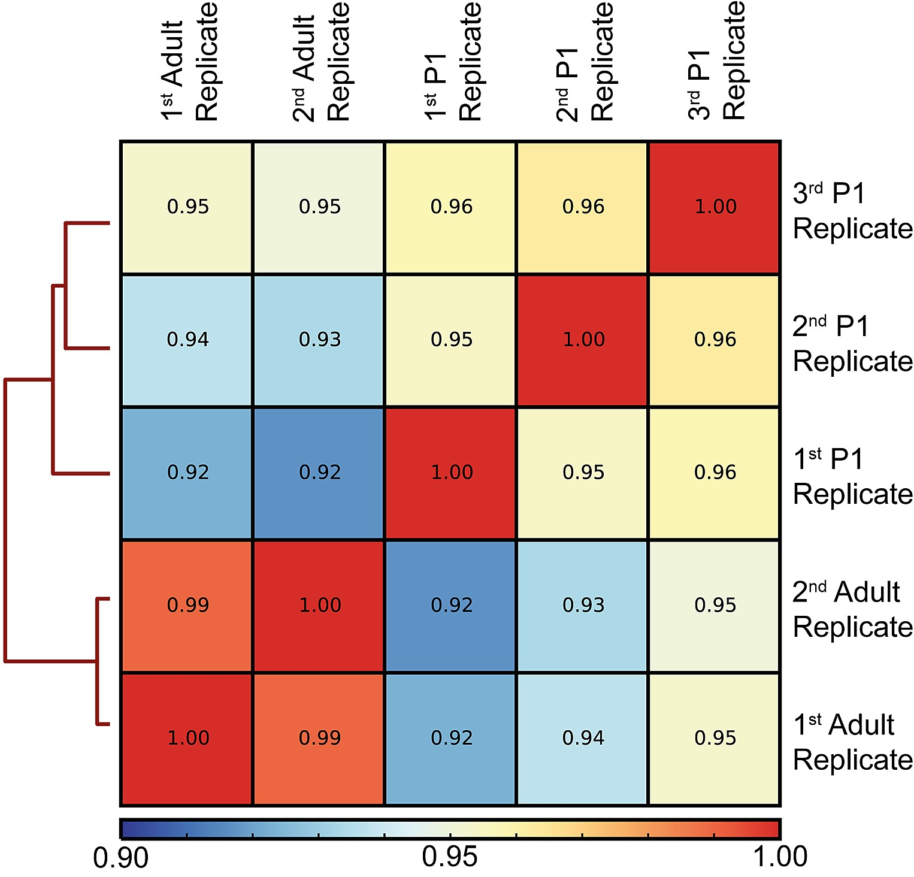
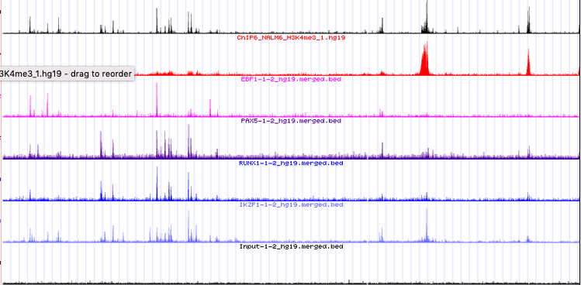
QC your samples!!!!
(even though we don’t today)
FastQC to check fastq-quality (before and after trimming). https://www.bioinformatics.babraham.ac.uk/projects/fastqc/
Correlation plots for sample correlation.
FRIP: Fraction of Reads In Peaks (should be above 0.2)
Eyeball the actual tracks on the genome browser.
More of this is covered in the visualization workshop.

Slide 11
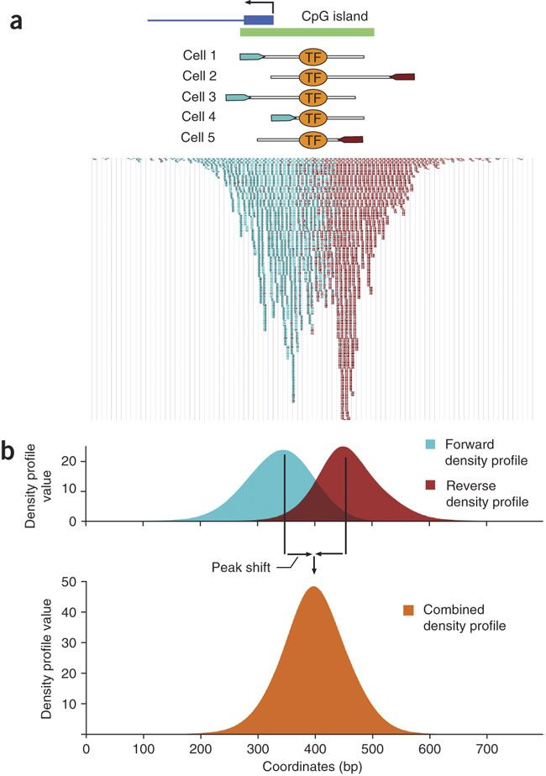
Why a peak caller cannot “see” the binding site
DNA is double stranded and a fragment will be sequenced from both direction.
An advantage with paired-end sequencing is that fragment size can be absolutely determined but has to be estimated for single-end sequencing.
Most sequencing technologies do not sequence the full fragments but 50-150 bp from each side.
Experimental limitation but the closer to the protein the more exact can the binding sequence be determined. Various protocols for this (ChIP-exo etc).
Therefore, a good peak caller needs to build a good “model” and this depends on the data type, if the peaks are narrow, broad or mixed etc.

Slide 12
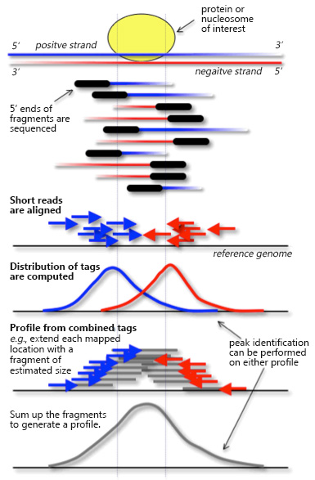
Why a peak caller cannot “see” the binding site
DNA is double stranded and a fragment will be sequenced from both direction.
An advantage with paired-end sequencing is that fragment size can be absolutely determined but has to be estimated for single-end sequencing.
Most sequencing technologies do not sequence the full fragments but 50-150 bp from each side.
Experimental limitation but the closer to the protein the more exact can the binding sequence be determined. Various protocols for this (ChIP-exo etc).
Therefore, a good peak caller needs to build a good “model” and this depends on the data type, if the peaks are narrow, broad or mixed etc.

Slide 13
Short on motif databases
A motif database is a database of previously identified consensus binding sites for many known transcription factors.
Knowledge of a motif makes it possible to make targeted searches of motifs of interested in predefined sequences and identify what sequences contain certain combinations of motifs and their spacing.
Many ChIP-analysis tools can work with pre-defined motifs but beware, they often differ in format.
MEME is good because it has access to many pre-packaged databases: http://meme-suite.org/doc/download.html and tools to convert in between formats http://meme-suite.org/doc/motif_conversion.html
Other databases:
JASPAR
Hoccomocco
Transfac
CISBP
Etc.

Slide 14
What we have and what we will do
TF, histone and ATAC-seq data from early T-cell development (DN1/ETP, DN2a and DN3).
ChIP-data is single-end sequenced (not optimal) and ATAC-seq data is paired-end but since they all come from the same system we can use them together for powerful analysis.
TF = PU.1
Histone mark = H3K4me2 (marks active promoters and enhancers).
Use Homer to call PU.1 and H3K4me3 peaks at the different stages of T-cell development.
Use MACS2 to call ATAC-peaks.
Use Bedtools to find overlapping peaks between replicates but also to identify binding in marked and open regions.
Annotate peaks with Homer annotatePeaks.pl (GREAT is also a, eh, great tool that we sadly won’t have time to cover).
Motif analysis with Homer and MEME.
Create tag distributions over bound regions.
Homework: How many PU.1 bound sites changes ATAC-accessibility significantly from DN1 to DN3
stages?

Slide 15
Resources
Tools:
HOMER: http://homer.ucsd.edu/homer/
MACS2: https://github.com/taoliu/MAC
Many other peak callers out there (SICER, FindPeaks etc. Google!!!)
deepTools: https://deeptools.readthedocs.io/en/develop/
GimmeMotif: https://gimmemotifs.readthedocs.io/en/master/
diffTF: https://readthedocs.org/projects/difftf/
MEME: http://meme-suite.org/
GREAT: http://great.stanford.edu/public/html/
Bedtools: https://bedtools.readthedocs.io/en/latest/
ENCODE ATAC- and ChIP-seq pipelines: https://www.encodeproject.org/pipelines/
GenRich (the untested new kid on the block): https://github.com/jsh58/Genrich
Lots of R-packages if you prefer that over command line tools (both Bioconductor or others).
Many many many more.
Other resources
Blacklisted region: https://sites.google.com/site/anshulkundaje/projects/blacklists
UCSC Genome and Table Browser: http://genome.ucsc.edu/ (also has tons of genomic annotations, repeat region maskers etc.)
UCSCs Kent Tools: An entire suite of handy software for bigWig-generation etc.

